Slide 1
Orbital Sight
AI-Powered Space Debris Prediction & Visualization

Slide 2
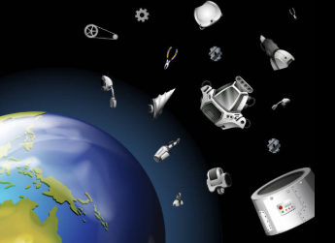
The Problem
36,000+ tracked debris objects (>10 cm) orbit Earth 🌍
Millions of smaller fragments → collision risks for satellites & astronauts
Past cases: ISS had to maneuver multiple times to avoid debris
Operators lack real-time, interactive tools

Slide 3
Our Vision
3D Visualization of satellites & debris
Prediction engine for close approaches (500–800 km shell)
Clustering algorithms to detect debris clouds
Risk heatmaps highlighting hazardous zones

Slide 4
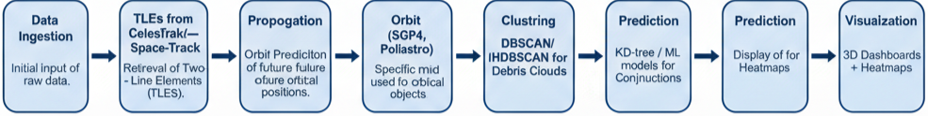
Methodology
Pipeline:
1. Data Ingestion → TLEs from CelesTrak/Space-Track
2. Propagation → Orbit prediction (SGP4, Poliastro)
3. Clustering → DBSCAN/HDBSCAN for debris clouds
4. Prediction → KD-tree / ML models for conjunctions
5. Visualization → 3D dashboards + heatmaps

Slide 5
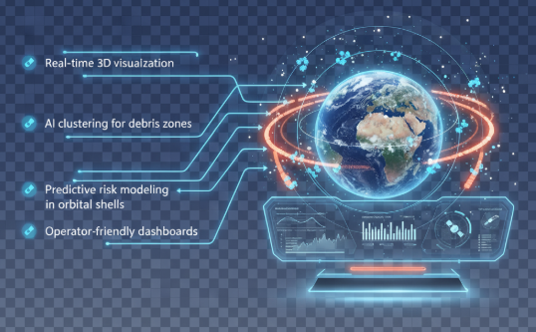
Innovation
🔹 Real-time 3D visualization
🔹 AI clustering for debris zones
🔹 Predictive risk modeling in orbital shells
🔹 Operator-friendly dashboards

Slide 6
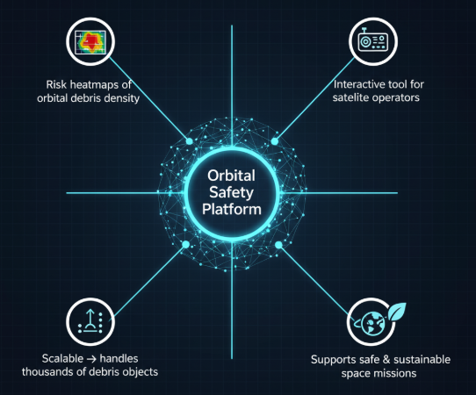
Expected Outcomes
✅ Risk heatmaps of orbital debris density
✅ Interactive tool for satellite operators
✅ Scalable → handles thousands of debris objects
✅ Supports safe & sustainable space missions

Slide 7
Impact
Safer Orbits 🚀
Smarter Mission Planning 🛰️
Sustainable Space Future 🌍

Slide 8
Judging Fit
.
💡 Innovation → Fusion of orbital mechanics + AI
⚙️ Technical Feasibility → Proven algorithms, public data
📈 Scalability & Practicality → Thousands of debris objects in real time
🎥 Clarity → Interactive visualization & clear storytelling

Slide 9
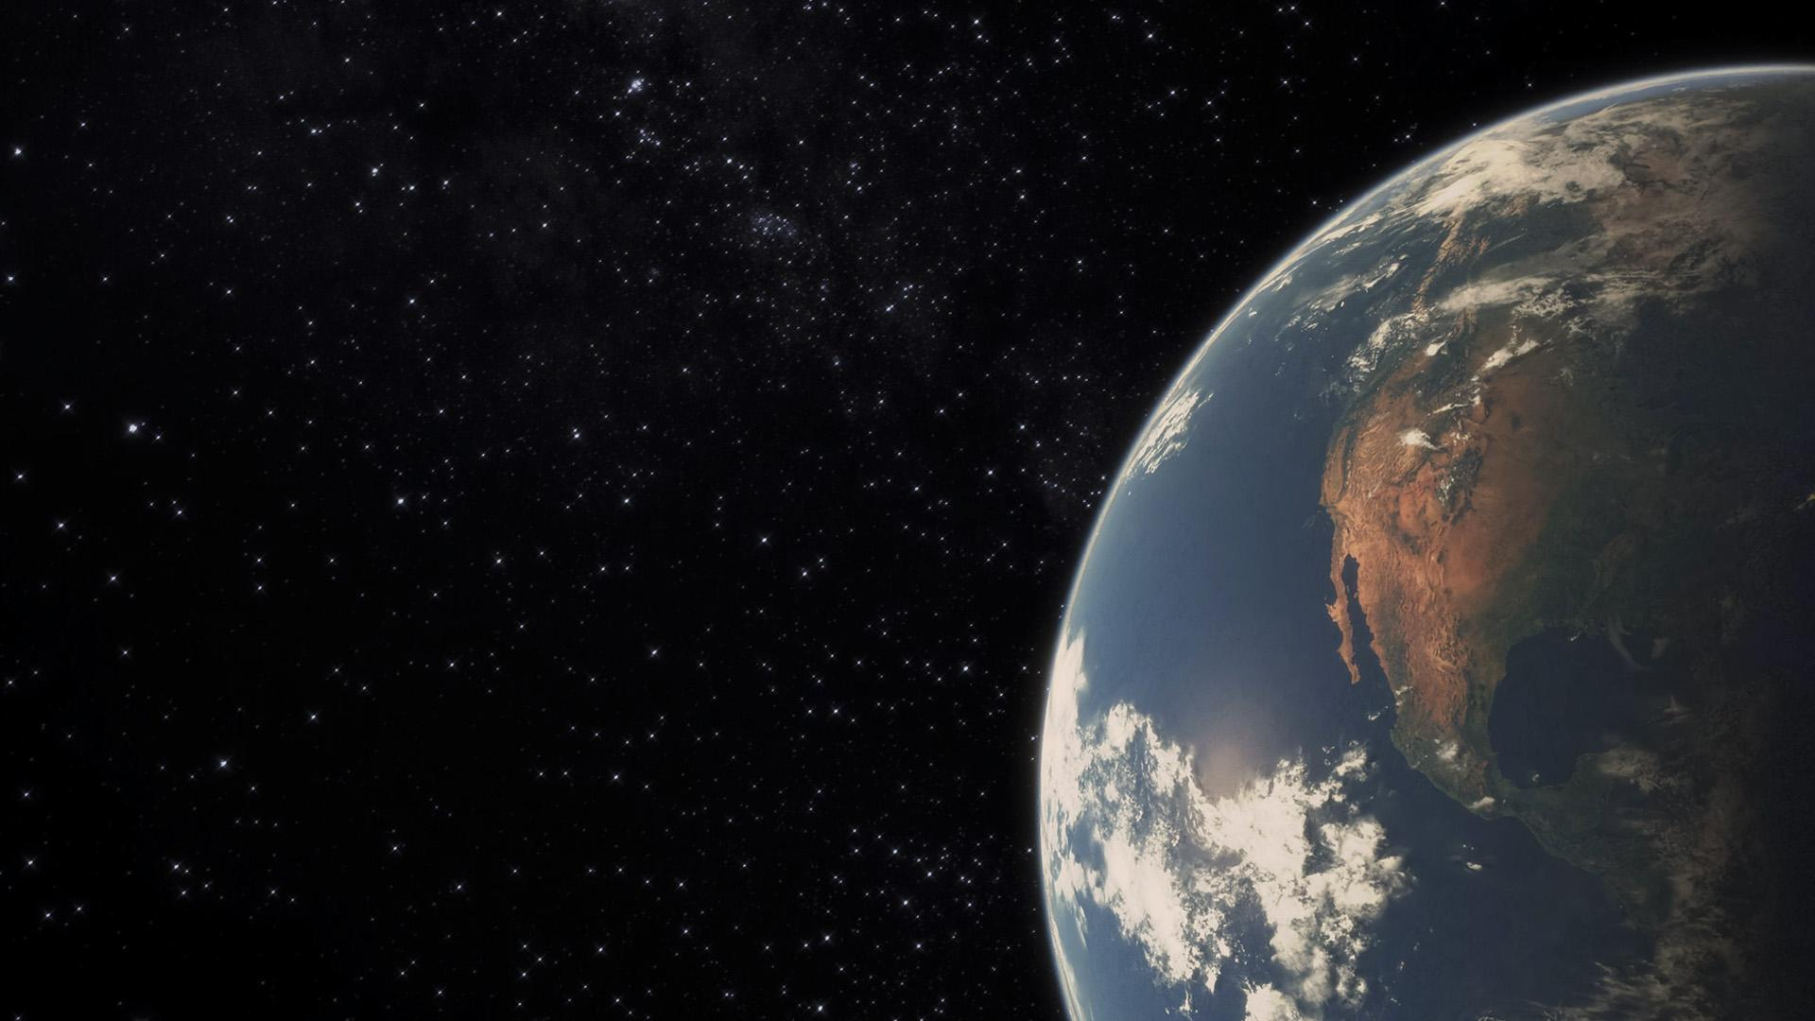
Thankyou
Team MindFirst
Thankyou

